Slide 1
Automatic Test Packet Generation

Slide 2
ABSTRACT
Test packets are sent periodically, and detected failures trigger a separate mechanism to localize the fault.
ATPG can detect both functional and performance problems .
ATPG complements but goes beyond earlier work in static checking ( which cannot detect liveness or performance faults) or fault localization (which only localize faults given liveness results).

Slide 3
EXISTING SYSTEM
Testing liveness of a network is a fundamental problem for ISPs and large data center operators.
Sending probes between every pair of edge ports is neither exhaustive nor scalable .
It suffices to find a minimal set of end-to-end packets that traverse each link.

Slide 4
DISADVANTAGES OF EXISTING SYSTEM
Not designed to identify liveness failures, bugs router hardware or software, or performance problems.
The two most common causes of network failure are hardware failures and software bugs, and that problems manifest themselves both as reachability failures and throughput/latency degradation.

Slide 5
PROPOSED SYSTEM
Automatic Test Packet Generation (ATPG) framework that automatically generates a minimal set of packets to test the liveness of the underlying topology and the congruence between data plane state and configuration specifications.
The tool can also automatically generate packets to test performance assertions such as packet latency.
It can also be specialized to generate a minimal set of packets that merely test every link for network liveness.

Slide 6
ADVANTAGES OF PROPOSED SYSTEM
A survey of network operators revealing common failures and root causes.
A test packet generation algorithm .
A fault localization algorithm to isolate faulty devices and rules.
ATPG use cases for functional and performance testing.
Evaluation of a prototype ATPG system using rule sets collected from the Stanford and Internet2 backbones.

Slide 7
SYSTEM ARCHITECTURE

Slide 8
HARDWARE REQUIREMENTS
System : Pentium IV 2.4 GHz.
Hard Disk : 40 GB.
Floppy Drive : 1.44 Mb.
Monitor : 15 VGA Colour.
Mouse : Logitech.
Ram : 512 Mb.

Slide 9
SOFTWARE REQUIREMENTS
Operating system : Windows XP/7.
Coding Language : JAVA/J2EE
IDE : Netbeans 7.4
Database : MYSQL

Slide 10
MODULES:
Test Packet Generation
Generate All-Pairs Reachability Table
ATPG Tool
Fault Localization

Slide 11
Test Packet Generation:
We assume a set of test terminals in the network can send and receive test packets. Our goal is to generate a set of test packets to exercise every rule in every switch function, so that any fault will be observed by at least one test packet. This is analogous to software test suites that try to test every possible branch in a program.

Slide 12
Generate All-Pairs Reachability Table:
ATPG starts by computing the complete set of packet headers that can be sent from each test terminal to every other test terminal. For each such header, ATPG finds the complete set of rules it exercises along the path. To do so, ATPG applies the all-pairs reachability algorithm described.

Slide 13
ATPG Tool:
ATPG generates the minimal number of test packets so that every forwarding rule in the network is exercised and covered by at least one test packet. When an error is detected, ATPG uses a fault localization algorithm to determine the failing rules or links.

Slide 14
Fault Localization:
ATPG periodically sends a set of test packets. If test packets fail, ATPG pinpoints the fault(s) that caused the problem. A rule fails if its observed behavior differs from its expected behavior. ATPG keeps track of where rules fail using a result function “Success” and “failure” depend on the nature of the rule: A forwarding rule fails if a test packet is not delivered to the intended output port, whereas a drop rule behaves correctly when packets are dropped.

Slide 15
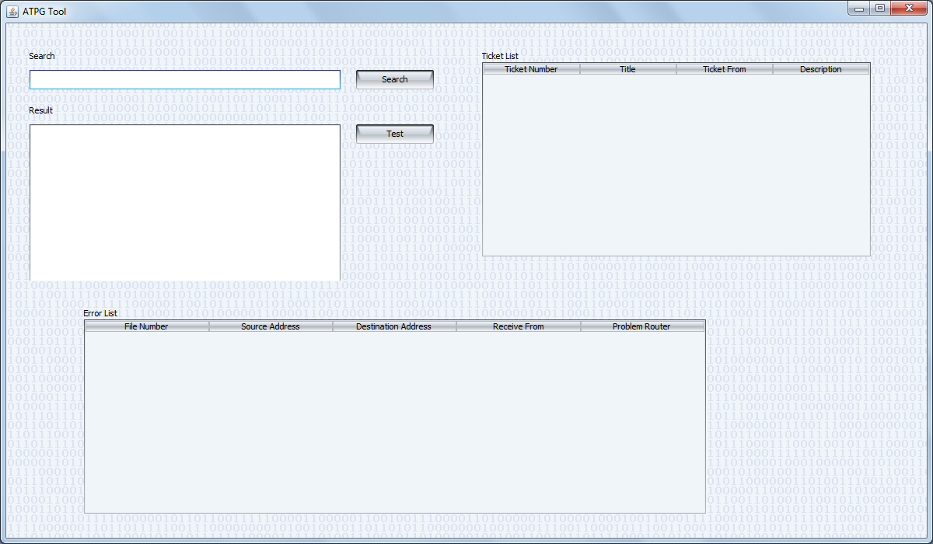

Slide 16
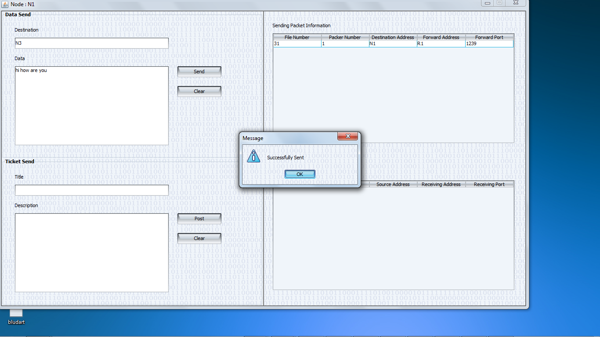

Slide 17
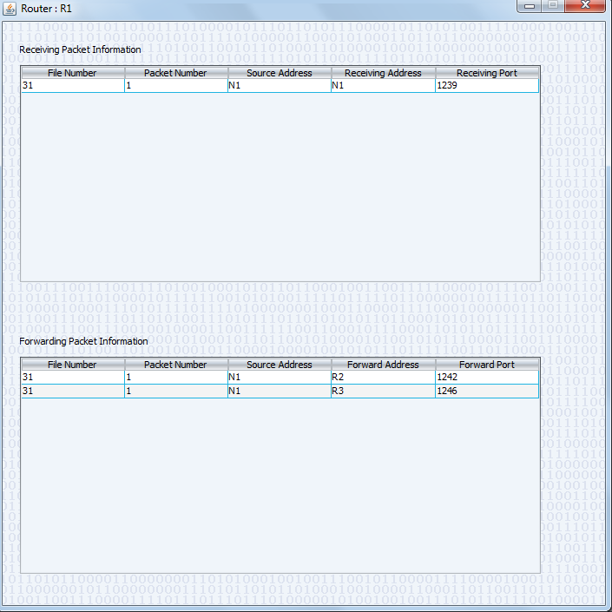

Slide 18
REFERENCE
Hongyi Zeng, Peyman Kazemian,George Varghese,and Nick McKeown,“Automatic Test Packet Generation”,VOL. 22, NO. 2, APRIL 2014.

